Slide 1
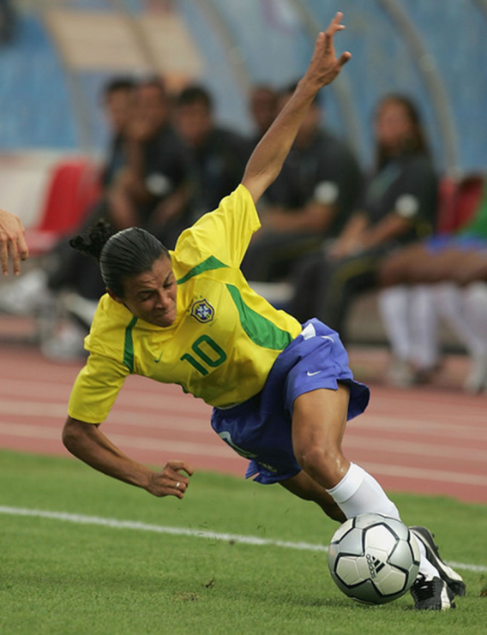
Adaptive Leadership: Accelerating Enterprise Agility
Jim Highsmith Executive Consultant

Slide 2
ThoughtWorks Initiative Overview
The GMT identified Adaptive Leadership (AL) as a Horizon 2 (emerging opportunity) initiatives for 2012. The ultimate goal of this initiative is to build better relationships with executives and managers in client organizations to improve our sustainable business pillar goals. Adaptive Leadership workshops with ThoughtWorks managers, MPs, and others would provide a framework and consistent tools to sell agile delivery, consulting services and products to client executives.

Slide 3
Adaptive Leadership Opportunity
Phase 1: Internal ThoughtWorks
To develop a commonly understood leadership framework that resonates with client executives and shows the strategic benefits from all of TW integrated products and services.
To provide TW management and sales staff with critical talking points with client executives.
To provide TW sales staff with another tool to qualify prospects.
To demonstrate continued thought leadership and innovation.
To provide TW management with ideas for internal development.

Slide 4
Adaptive Leadership Opportunity
Phase 2: For Clients (Maybe)
To provide customer executives and managers with a better understand their role in transforming IT, particularly the agility piece.
To help executives and managers move beyond agile software delivery teams by to the enterprise level by providing them a roadmap for success.
To show how Adaptive Leadership can be key to implementing Continuous Delivery successfully.

Slide 5
Feedback: 80+ Managers at Travelocity, Dallas in April (CEO/CIO)
Jim knows his stuff
Loved the topic! Wish we had more time to take it from abstract to concrete execution plans specific for us.
Purchased a couple of books after his presentation on recommendations that seemed appropriate for us.
The presentation was too high level, and it would have been good to go into some detail.
Good information. I would like to see him apply his theories to actual situations at Travelocity and provide us recommendations on how to proceed.
Jim asserted experience and really made me fell that we can achieve this transformation. Where I sit in the organisation i feel I have to go back to my team and prepare them for the agile practices that will come our way.
-more time from Jim Highsmith would have been great!
I was interested in the topic and the presenter was good but extremely theoretical. It would have been nice to take discussions to the next level and talk in detail about problems. I liked it but it could have been better.
LOVED IT!!!!!
Great use of experiences to add depth to the presentation.
Although I knew about the topic he presented, I enjoyed his presentation. The choosing of an experienced person with many years working in technology, to talk about adaptive leadership, had a good impact on the audience and it could show that the change can be done in every age
It was great to have Jim in house. Amaizing to have one of the Agaile pioneers.I totally agree we need to adapt, and BE agile as opposed to doing agile. His presentation was clear and motivating.
Very short for such an important topic
This was one of my favorite presentations. Extremely informative and thought provoking.
Thoroughly enjoyed this external perspective, and found Jim both engaging and enthusiastic about his subject.
Jim is an very credible spokesperson on this subject. It was good to hear best practices from him that we can all start embracing (some teams are further along than others)

Slide 6
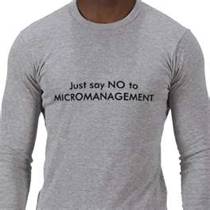
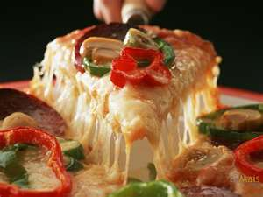
Don’t micro-manage
Buy pizza and get out of the way
Notes:
The Agile community has gone to great lengths to define technical and management practices
Along the way, a lot of us have been told that our role in all this is to get out of the way and stop micro-managing
So we know a lot about what NOT TO DO
But it’s just as important for us to understand what TO DO
So that’s what this presentation is about: “What is macro-management?”

Slide 7
Goals of Adaptive Leaders
Envision a Responsive Enterprise
Create an Innovative Culture
Deliver a Continuous Stream of Value
Why Agile?
Be Agile
Do Agile

Slide 8
Agility is a Strategic Issue
“88% of executives cite organisational agility as key to global success.”
“50% say that agility is not only important, but a core differentiator.”
Source: The Economist, Special Report on Agility, March 2009
Notes:
So Agility is now a strategic issue for most organisations
Economist 2009 – interviews with 350 global CEO’s and CIO’s
88% say organisational agility is key to global success
50% say it is a core differentiator

Slide 9

Opportunity
…exploit the change
Danger
…survive the change
Notes:
Faster cycles and constant change are making it harder and harder for businesses to compete – we’re living in Turbulent times
Upside of Turbulence – Donald Sull - Turbulence can be a good thing or a bad thing: Opportunity and Danger
2 sides of Enterprise Agility – need to be agile enough to:
Exploit the change to GET AHEAD
Survive the change to STAY ALIVE

Slide 10
Are We at an Inflection Point?
“Every decade or so since the beginning of the computer age there comes a platform change...”
2000 - the Web
2012-mobility (individuals), cloud (system) plus big data and social media
Source: “The Impact of Technology Mega-Trends on Corporate IT and Business Models,” Tuck School of Business at Dartmouth.

Slide 11

Social Business is Big Business
Dell’s Social Media Command Center monitors Facebook, Twitter, and more in the blogosphere. In 13 languages, effectively in every country.
“It’s really 24/7, and you can’t even take a tea break.”
Source: “The Impact of Technology Mega-Trends on Corporate IT and Business Models,” Tuck School of Business at Dartmouth

Slide 12
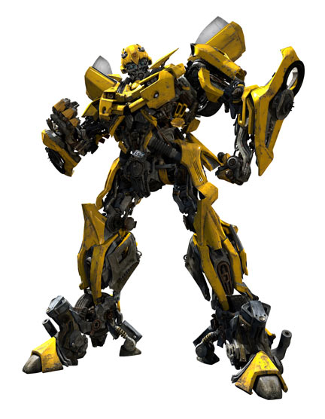

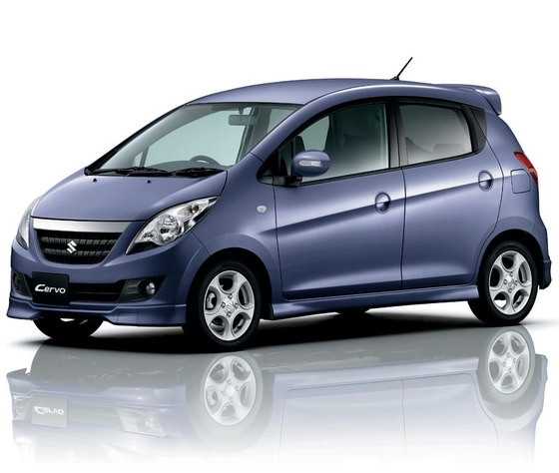

Core Business Strategies
Responsiveness
Efficiency
Notes:
We obviously do both, but one is the goal and the other a constraint.
Exploration vs. Exploitation

Slide 13
“Those are the only two choices. Win by being more ordinary, more standard, and cheaper. Or win by being faster, more remarkable, and more human.” --Godin, Seth. (2010). Linchpin: Are You Indispensable?

Slide 14
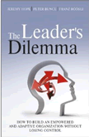
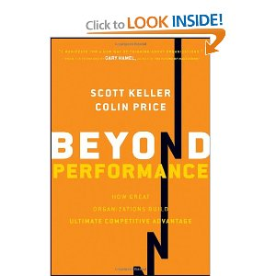

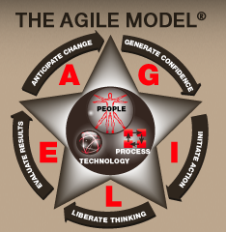
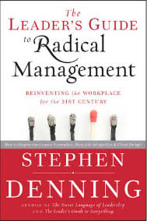
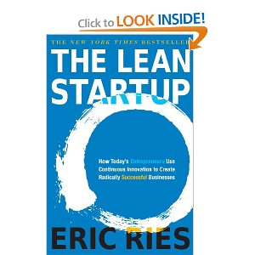
Beyond Budgeting
Lean (lean startup)
Next Gen Management

Slide 15



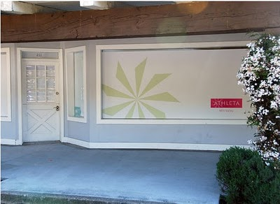

Business Responsiveness
Notes:
Great story which illustrates the difference in mindset between orgs that have Responsiveness vs. Efficiency strategies
Sep 2008 Gap acquired a brand of high end athletic gear for women – online within a few months
Women wanted to SEE the clothes
CEO Online -> CEO Corporate: ??? Brick and Mortar: 12-14 months
Exploit opportunity=prove business model and customer profile, then scale
Online group: ¼ of that time – a few months
Responsiveness mindset: prototyped, took shortcuts and improvised, e.g. Quick Books instead of corporate accounting system
vs.
Efficiency mindset: large efficient stores

Slide 16
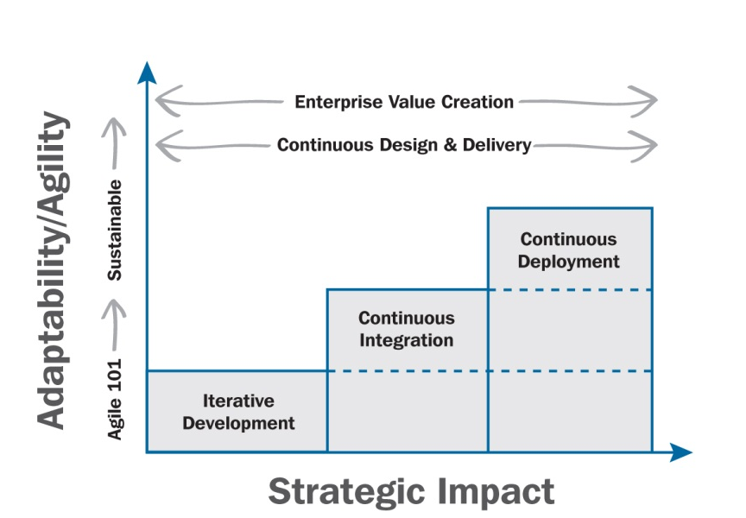
Strategy & Continuous Delivery
Increasing Commitment
Increasing Benefit & Investment
Notes:
Story: Agile project in 1992, big bank, 1 mth project, 1 week iterations. Operations 4-6 months to put in production.
Continuous development: Iterative features developed.
CI: Comprehensive automated tests. 500-person software company, 41 of 42 passing. Versus Salesforce, 60,000+.
Cont Deployment: Push button deployment, automated release, automated roll-back.

Slide 17
Two Strategic Questions
In what ways does our business need to be more responsive?
If we could deliver solutions much faster via continuous design & delivery, how could we take advantage of that?

Slide 18
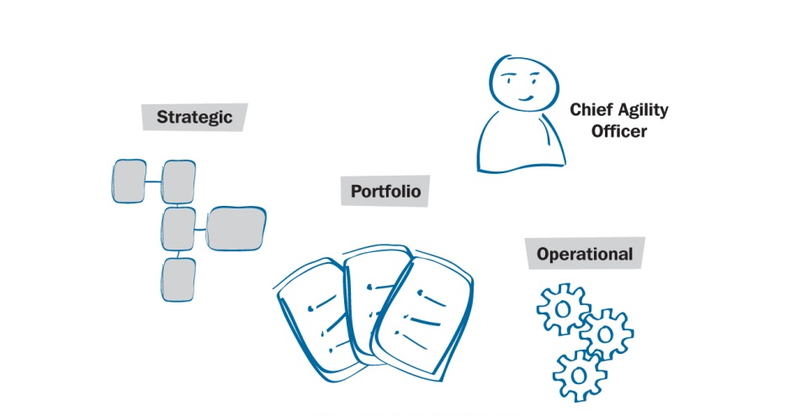
Levels of Agility/Delivery
Notes:
Operational—engineering, individual projects, little high-level support, little business support
Portfolio—Specific criteria for agile/non, visibility @ portfolio level, still engineering centric

Slide 19



Agile Business Examples
“Few organizations have been able to implement the organization designs necessary to support flexibility or the capabilities to ensure that change can be routine. Capital One has met both of those criteria.”
Study by USC Center for Effective Organizations
Notes:
Suncorp
#1 in Oz in Insurance, #5 in banking, #1 in NZ insurance
CEO Jeff Smith, Suncorp Business Services, formerly CIO who brought Agile methods to IT, not expanding
Agile & Lean (streamline, simplification, rationalization, responsiveness)
Agile Academy

Slide 20


Why Adaptive Leadership?
Better Performance
Engaging Work Environment
Notes:
This would be in the last section, maybe in the wrap up. These two outcomes are the core of agile principles.

Slide 21
Battle for the Future
Do Agile
Purpose
Be Agile
Organizational
Health
Performance
Customers
Enterprise
(Adaptive Leadership)
Talent
Shareholders/Financial Markets
Notes:
This would also be at the end. It shows that the big battles for the future are for customers on one side and for talent on the other, therefore the need for adaptive practices and principles. The smaller box shows that shareholders and financial markets are still important, but not primary.

Slide 22
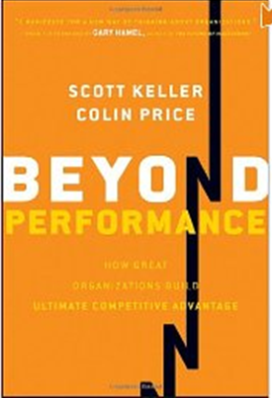
How Important is Health (Being)?
“Organizations that focused on performance AND health simultaneously
were nearly twice as successful as those that focused on health alone,
and nearly three times as successful as those that focused on performance alone.”
Beyond Performance: How Great Organizations Build Ultimate Competitive Advantage, Scott Keller & Colin Price (McKinsey & Co.)

Slide 23
Extensive Beyond Performance Research
Surveys: 600,000 respondents, 500 companies
6,800 CEO’s & senior executives
Reviews: 900 books & academic journals
Personal interviews: 30 CEO’s
Data from: >100 McKinsey clients

Slide 24

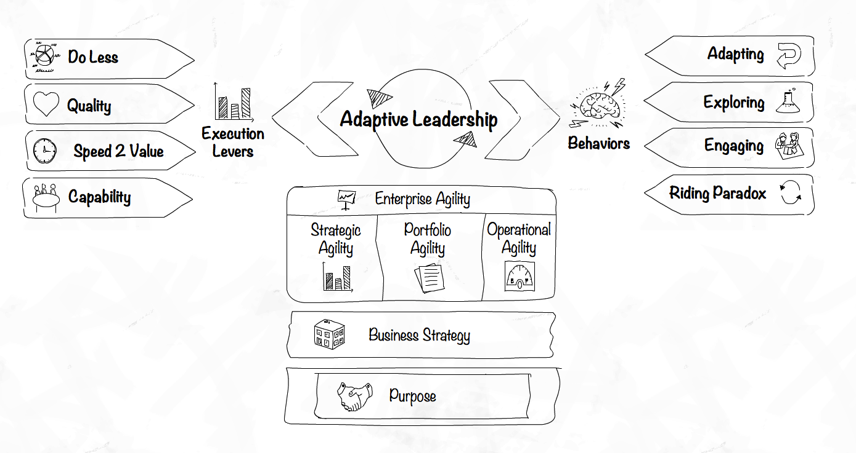

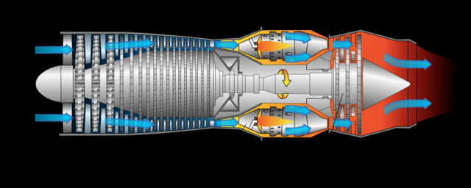

Slide 25
Agenda
Envision a Responsive Enterprise
Create an Innovative Culture
Deliver a Continuous Stream of Value
Why Agile?
Be Agile
Do Agile
Practices & Process

Slide 26
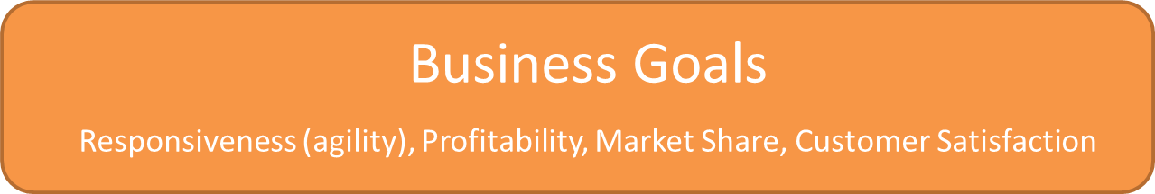

Managers & Key Links
Execution Levers
Notes:
It’s our job to make the link between what the business is trying to DO and what software delivery teams DO
And we have some key Execution Levers to make this happen

Slide 27
The Full Monty
Lean Customer Discovery
Agile Product Delivery
Notes:
Bringing the Lean startup into the deck. This would be somewhere in the why section.

Slide 28
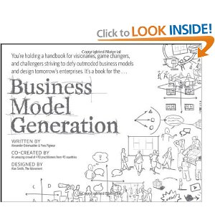
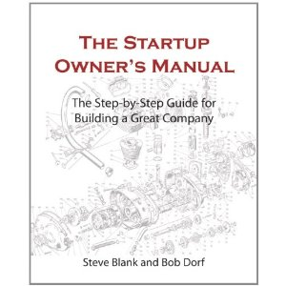
Lean Start Up Principles
Entrepreneurs are everywhere
Entrepreneurship is management
Validated Learning
Build – Measure - Learn
Innovation Accounting
Notes:
Innovation accounting: NOT VANITY Metrics
Example: not # of hits, but click throughs (10,000 to 2)

Slide 29
Execution Levers
Do Less
Quality
Capability
Speed to Value

Slide 30

Continuous Delivery of Value
Feature Backlog Items
Running Tested Features
Value: High value features
Cycle Time: Concept to cash
Throughput: Volume of features
Notes:
When Utilization goes up, cycle time goes down—they need to be balanced.

Slide 31

Do your systems look like this?
Do you think it impacts your agility?
Notes:
Engineers deliver quality, managers control quality
Many organisations have systems no one will touch – they will break in places where no one understands why and they’ll never be able to put Humpty Dumpty back together again
A lot people think managers and leaders have very little impact on quality – it’s up to the developers and testers
But this is just not true. There are too many real-world examples that suggest otherwise. At a TW client, the team was measuring code toxicity and a spike led to discovering change in manager
As leaders we can have a dramatic impact on quality – both in the positive and negative sense
Perceived Dilemma: perfection vs. nice-to-have
On the one hand we’re sceptical of what we perceive as developers’ desire for perfection
On the other hand we know we always want more features
We play these two things off against each other and we always go for more features because that’s what we can “see” today – it’s much harder to “see quality” until it’s too late

Slide 32
Quality Issues (technical)
Code quality
Design quality
Automated testing
Technical debt reduction
Blah, blah, blah is what your business partners hear!

Slide 33
Historical Dilemma
Quality
Features
Business Outcome
Technical Outcome

Slide 34
What if?
Features
?
Business Outcome
Business Outcome

Slide 35
What if?
Features
Cycle Time
Business Outcome
Business Outcome

Slide 36
The Consequences of Waterfall
Plan, Develop, Build, Test, Release
Maintain
12+/- months
Hundreds of features
Serial Development
Weeks
Few Features
Serial Development
Feedback from poor quality is long term
Consequences of low quality difficult to determine

Slide 37
Agile & Continuous Delivery
3-6 mths
3-6 mths
3-6 mths
Milestone 1
Milestone 2
Milestone 3
R1
R2
R3
…
R1
R2
R3
…
R1
R2
R3
…
Weekly Releases
Feedback immediate, a matter of weeks Consequences of low quality easier to determine.
Goal Not Features, but Continuous Stream of Value!

Slide 38
Quality Matters
Scientific Instrument Company, Canada
Average results from 6 before- and 6 after-Agile projects
 | Pre-Agile | Post-Agile | % Improvement
Project Cost | $2.8 M | $1.1M | 61%
Project Schedule | 18 months | 13.5 months | 24%
Cumulative Defects | 2,270 | 381 | 83%
Staffing | 18 | 11 | 39%
Source: Michael Mah, QSM Assosciates
Notes:
Metrics gurus like Capers Jones (1980’s/90’s) and more recently Michael Mah have been studying the effects of Quality on schedule and cost for decades now
They’ve analysed loads of projects and data and one thing is absolutely clear: Everything – cost, schedule, scope – everything is linked to directly linked to quality
Here’s an example from a recent study by Michael Mah which illustrates that – many more out there to support it
The difference between successful and unsuccessful Agile implementations is a commitment to testing and software quality

Slide 39
Too Much Debt (Technical Debt)
Once on far right of curve, all choices are bad ones
Do nothing, gets worse
Replace, high cost/risk
Incremental investment
Estimating nearly impossible
Customer Responsiveness
Delivery Speed
Notes:
Virtuous vs Vicious cycle

Slide 40
Speed to Value
“To create a profile of dexterous organizations, we grouped those CEOs who recognized the value of fast decisions, an iterative approach to strategy, and the ability to execute with speed.”
Source: IBM—Capitalizing on Complexity: Insights from the Global Chief Executive Officer Study (2010)
Notes:
We’ve talked about Quality, now we’re going to talk about Speed to Value
This a quote – again from that IBM study – which highlights over and over the importance of having the ability to execute with speed

Slide 41
Speed to Value: The Agile Triangle
Value
(Releasable Product)
Quality
(Reliable, Adaptable Product)
Constraints
(cost, schedule, scope)
Notes:
If our business strategy is to be Responsive and Agile then we have to change what we measure
Jim’s Agile Triangle: from his book Agile Project Management - Addresses the real goals of projects:
Constraints are important, but not the goals of a project – establish clear boundaries within with the team must operate
Value: Producing products that delight our customers and help us win competitive advantage in the market
50% or more of functionality delivered is rarely or never used (scope is clearly a very poor project control mechanism)
Instead of asking: “Did we implement all the requirements?”, ask: “Can we release this product now?”
Quality: Building in quality that speeds development and creates a platform for future enhancements
Short iterations
Short planning cycles
Fewer Features
Value over Features

Slide 42
Enterprise Value Contributions
EVCs
Purpose
Profitability
Faster to Market
Increased Revenue
Ultimate Reason
Open New Markets
Reduce WIP
Be Continuous
Social Action
Learning & Adapting
Facebook Purpose: “To make the world more open and connected.”

Slide 43
Value Dials
Purpose
Reduction in specific target diseases (health care organization)
% profit spent on social responsibility
Financials
Headcount Reduction (# of H/C reduced or avoided) x (Average burden rate for region & job type)
Headcount Turnover
Risk Avoidance (Value of risk) x (Probability of occurrence)
Time-To-Market (Value of increased market segment share) x (# weeks accelerated to market)
Learning and Adapting
New practices initiated this quarter
…

Slide 44
Value Calculation Framework
We need to understand both Value and Cost at the Capability/Feature level.
Source: Pat Reed

Slide 45
Value Point Assignment and Allocation
Value Points get allocated across all Capabilities and Features based upon their relationship to individual Business Value Dials
Project A:
NPV = $5 million
NPV = $5 million
“Sales Increase”
5,000 Value Points
NPV = $---K
“Customer Experience”
250 Value Points
NPV = $---K
“Other”
150 Value Points
…allocation of Value Points
across Capabilities and Features…
Capability A
(25%)
Capability B
(40%)
Capability C
(35%)
Capability D
(100%)
Capability D
(100%)
Feature
A
(35%)
Feature
B
(30%)
Feature
C
(15%)
Feature
A
(25%)
Feature
B
(50%)
Feature
C
(25%)
Feature
A
(10%)
Feature
B
(25%)
Feature
C
(40%)
Feature
A
(35%)
Feature
B
(45%)
Feature
C
(20%)
Feature
A
(60%)
Feature
B
(20%)
Feature
C
(20%)
Feature
D
(20%)
Feature
D
(5%)
Feature
E
(20%)
Source: Pat Reed
Notes:
45

Slide 46
Features with Value Points
As a sales associate, the ability to calculate the total amount of the sale.
As a sales supervisor, the ability to Verify the adequacy of the Customer’s Credit Rating.
V-13
C-5
V-2
C-3
As a sales executive, the ability to view all sales by product type, geographic region, and sales associate.
V-11
C-8
Feature Points are a calculation of cost.
Value Points are an allocation of revenue.

Slide 47
Reporting Differently (Report courtesy Jeff DeLuca)
Establish Product Catalog (PC)
Establish Network Arrangement (NW)
PS
PS
PS
PS
PS
LT
LT
LT
LT
Establish
Product
(12)
Establish
Product
Attributes
(15)
Establish
Product
Attribute Groups
(12)
Establish
Templates
(7)
Establish
Autodesign
Mapping
(6)
Establish
Site
(11)
Establish
Node
(14)
Establish
Network
Element
(9)
Establish
Equipment
(15)
100%
100%
100%
100%
100%
100%
100%
100%
100%
Oct 2000
Nov 2000
Nov 2000
Dec 2000
Dec 2000
Oct 2000
Oct 2000
Oct 2000
Dec 2000
Establish Design Product (DP)
Establish Diversity (DV)
Establish Order (OM)
JM
JM
JM
PS
LT
LT
PS
JM
JM
JM
Establish
Products and
Models
(9)
Establish
Design Items
For Models
(26)
Explode
Design
Model
(19)
Establish
Diversity
Levels
(19)
Generate
Constraints
(20)
Check
Constraints for
A Pathing Point
(13)
Capture
Details
(17)
Generate and
Track
Site Events
(16)
Generate and
Resolve
Order Activities
(13)
Run
Autodesign
(24)
100%
100%
42%
100%
89%
1%
100%
1%
Oct 2000
Oct 2000
Feb 2001
Oct 2000
Dec 2000
Jan 2001
Dec 2000
Apr 2001
Mar 2001
Apr 2001
Inter-System Pathing (XP)
Users (UM)
System Selection (SS)
PS
PS
PS
PS
PS
PS
JM
PS
PS
PS
A-Z
One Hop
(14)
A-Z
2 Hops
(21)
A-Z
Multiple Hops
(22)
Establish
Pathing
(19)
Comply with
Diversity
Constraints
(13)
Protection
(4)
Establish User
(11)
Establish
Cost
(7)
Select Bearer
System
(7)
Logical Bearer
Systems
(13)
100%
100%
89%
100%
100%
100%
100%
Dec 2000
Dec 2000
Dec 2000
Dec 2000
Mar 2001
Mar 2001
Nov 2000
Dec 2000
Dec 2000
Apr 2001
Intra-System Pathing (SP)
Establish Trails (TR)
JM
JM
JM
JM
JM
JM
CA
LT
CA
PS
Physical
Design
(33)
Hubbing
(20)
Satisfy
Transport
Item
(16)
Route through
Bearer System
(25)
Protected
Route
(8)
Autodesign
Transport
Shortfall
(14)
Establish CIX
Trail Design
(15)
Lookup CI
Trail Design
(23)
Retest Trail
Diversity
(18)
Save
Trail Design
(10)
0%
0%
100%
100%
Apr 2001
Apr 2001
Feb 2001
Feb 2001
Apr 2001
Apr 2001
Dec 2000
Apr 2001
Apr 2001
Apr 2001
KEY: Work In Progress Attention Full Completion Progress Bar
Notes:
Reformatted slide background, title

Slide 48
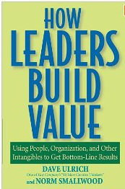
Intangibles
Intangibles assets are not reflected on or Balance Sheets.
Intangibles are reflected in Market Capitalization.
Impact of Intangibles on Market Value
Year | Intangible % | Tangible %
1982 | 38 | 62
1992 | 62 | 38
2000 | 85 | 15
How Leaders Build Value, Ulrich & Smallwood
Notes:
Discovery: patents, R&D programs, innovations
Organization: brands, technology
Human resource: training, culture, leadership

Slide 49
Do Less (But Get More)
Do the simplest thing possible that delights the customer
+ Value
+ Throughput
+ Quality
+ Innovation
Notes:
Paul Young Story

Slide 50
Do Less: Eliminate Marginal Value
2% of code used as written
$35 Billion, DOD Software
Crosstalk Journal 2002
< 5% of code used
Commercial Software
400 projects over 15 years IEEE conference 2001
64% of code never or rarely used
Standish Group Study,
reported by CEO Jim Johnson, XP2002
Notes:
>50% of functionality is rarely or never used
Biggest payback from agile is what we don’t do
3 different studies about a decade ago which backs this up with some pretty staggering data
Question here is: What if you could reduce the amount of software you write by even 15-20%?
How much would you save and where could you redirect that investment?

Slide 51
“Everyone tries to do too much: solve too many problems, build products with too many features. We say ‘no’ to almost everything. If you include every decent idea that comes along, you’ll just wind up with a half-assed version of your product. What you want to do is build half a product that kicks ass.” Quotes from the founders of 37signals in Practically Radical by William Taylor, 2011)

Slide 52
Traditional Value Curve

Slide 53
Agile Value Curve
Strategies
Most valuable first
Evolve features
Determine right cut-off
Where is the right cut-off point?

Slide 54
“ …innovation is not about saying "yes" to everything. It's about saying "no" to all but the most crucial features.”
Steve Jobs, (former CEO Apple Computer Inc)

Slide 55
Build Capability
People
Technology
Process
Culture

Slide 56
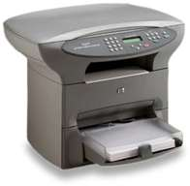

The Possible—HP’s FutureSmart
Goal: Revamp HP LaserJet software across product line
Common software
Adaptable
Applications
5% to 40% innovation
Cycle time from 2 months to 1 day
Reduced development costs by 40%
Enterprise Agile planning & prioritization
400 people, distributed
Complex and fast changing market
3 years for transformation
Started with CI & CD!
Source: Practical Large Scale Agile, Gary Gruver, Mike Young, Pat Fulghum, Addison Wesley mid-2012
Notes:
Complex (firmware, multiple products supported, complete architectural revamp), and fast changing (market conditions)

Slide 57
Build a Responsive Software Delivery Engine
WIP
Value
Feature Backlog Items
Running Tested Features
Measures:
Value
Cycle Time
Throughput
Technical debt
Do Less
Quality
Notes:
When Utilization goes up, cycle time goes down—they need to be balanced.

Slide 58
Software Delivery Evolution
12+ months
After 12+ months
Project
Build
Maintain
9-12+ mths
9-12+ mths
9-12+ Mths
Product
Release 1
Release 2
Release 3
3-6 mths
3-6 mths
3-6 mths
Continuous Delivery
Release 1
Release 2
Release 3
D1
D2
D3
…
D1
D2
D3
…
D1
D2
D3
…
Days to Weeks
Days to Weeks
Days to Weeks

Slide 59
Portfolio
Product/ Project | Value | Size | Cycle Time | Risk | …
Web Sales | ***** | Medium | 1 week | Moderate | …
Accounting Upgrades | * | Small | 3 months | Low | …
Product Mobility App | *** | Small | Daily | High | …
Agile Portfolio Management: From Strategy to Execution

Slide 61
Agenda
Envision a Responsive Enterprise
Create an Innovative Culture
Deliver a Continuous Stream of Value
Why Agile?
Be Agile
Do Agile
Values & Principles

Slide 62
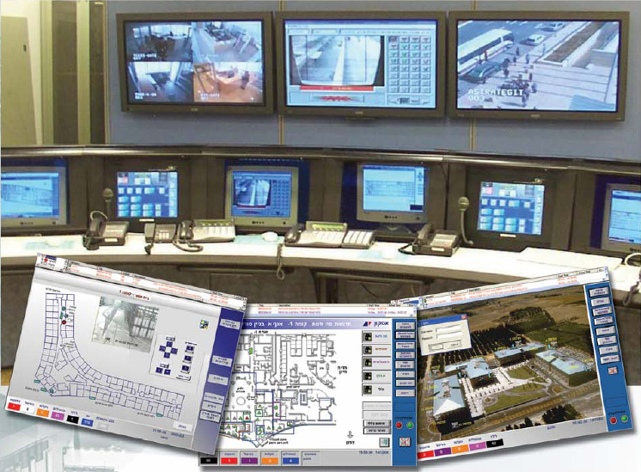
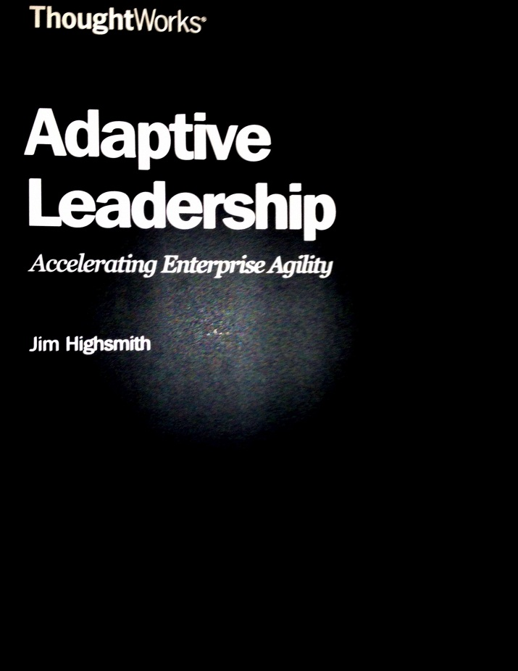
Command-Control
Adaptive Leadership

Slide 63

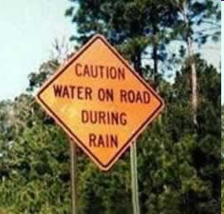
Simple Rules — Dee Hock
“Simple, clear purpose and principles give rise to complex, intelligent behavior.”
“Complex rules and regulations give rise to simple, stupid behavior.”

Slide 64
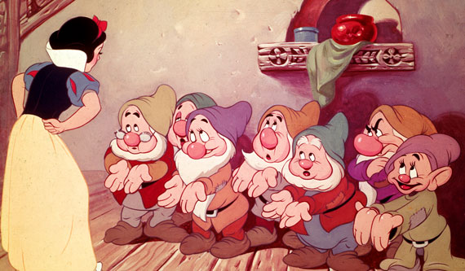
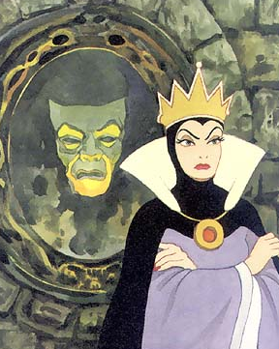
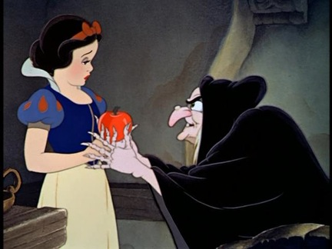
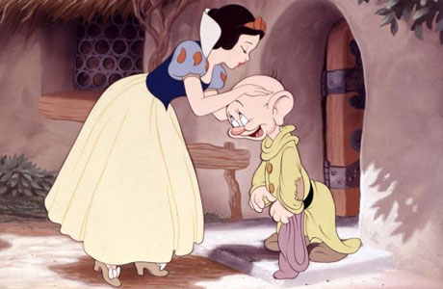
Notes:
“Organizing Genius,” by Warren Bennis – leading the field of leadership studies, since 1960’s
Walt Disney example:
- He wasn’t the best animator or the best artist
Create a vision, act out each of the roles
Talk to people and get them to interact with each other
Give them constraints to work with (by Christmas)
He spent a lot of time on vision and helping people collaborate and then let them get on with it

Slide 65
Adaptive Leadership Mindset
Adapting
Exploring
Riding Paradox
Engaging

Slide 66
It is difficult to make predictions, especially about the future. Yogi Berra

Slide 67
Adapting
A traditional manager focuses on following the plan with minimal changes, whereas an agile leader focuses on adapting successfully to inevitable changes.
–Jim Highsmith
Notes:
Everyone agrees that change is inevitable, but few put the right mechanisms in place to adapt
Learning to trust your organization’s ability to adapt, but still perform, is hard.
Adaptation is a natural process that can be goal-directed, but not controlled.

Slide 68
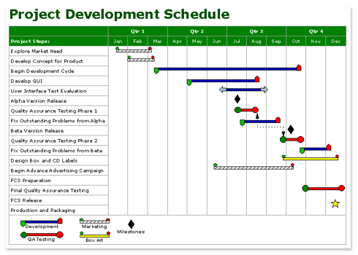
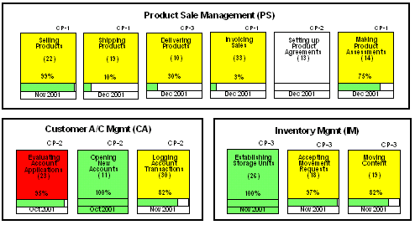
Predictable versus Adaptable
Notes:
Adaptive mindset means being (1) OPEN to change AND (2) UNDERSTANDING the change process
Traditional Gantt chart with time and tasks: but tasks usually meant nothing to the business so difficult to change it to reflect changing business priorities
People focused on conforming to the plan as opposed to satisfying the business needs
FDD Parking Lot – from Jeff De Luca, creator of FDD – it’s innovation was to start to organise work by value
We can adapt more quickly if we organise ourselves by value: business can adjust value prop and reorient software teams to reflect those new priorities
Understand how change trickles through our organisation, our strategic initiatives and down into our projects

Slide 69
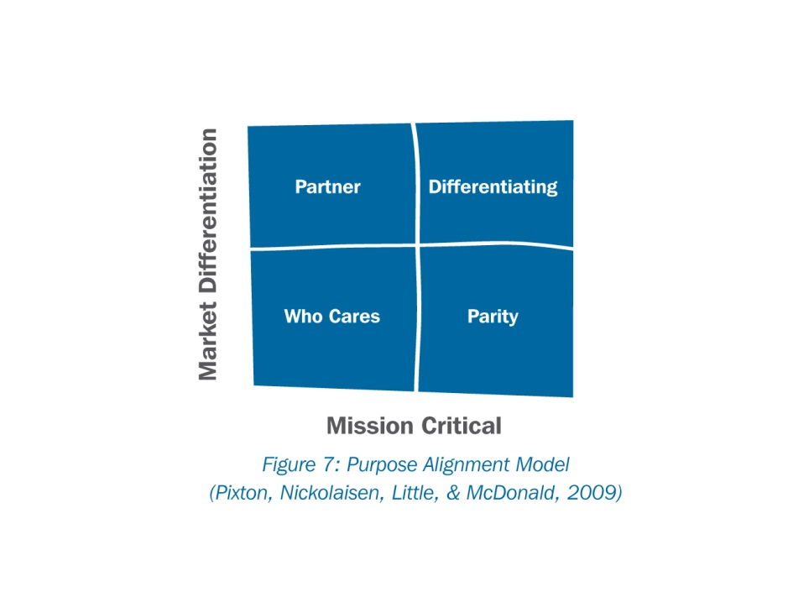
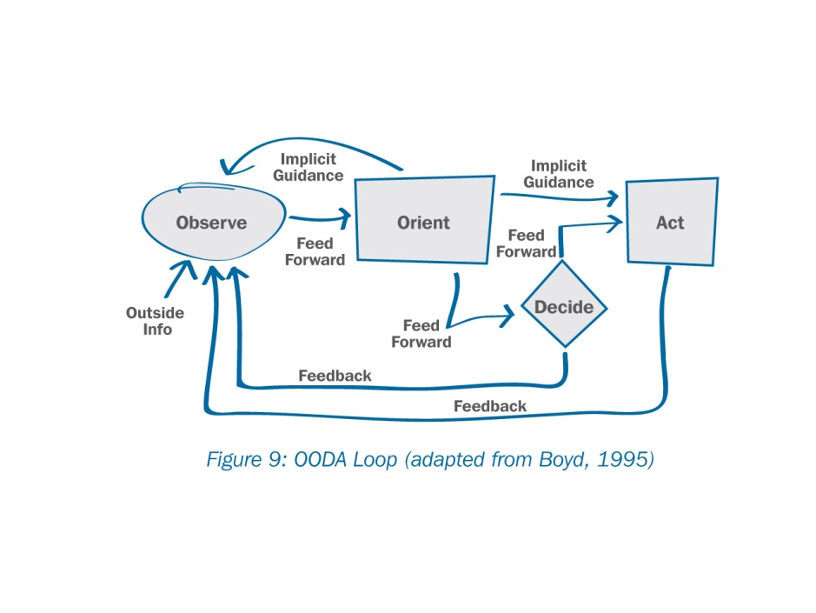
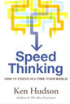
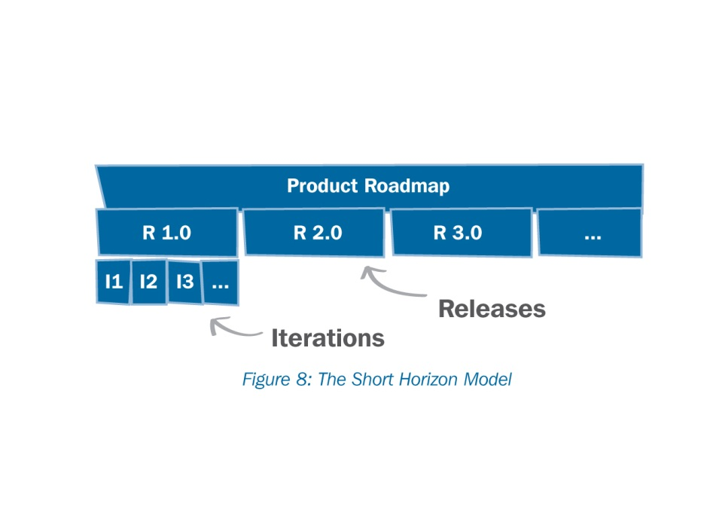
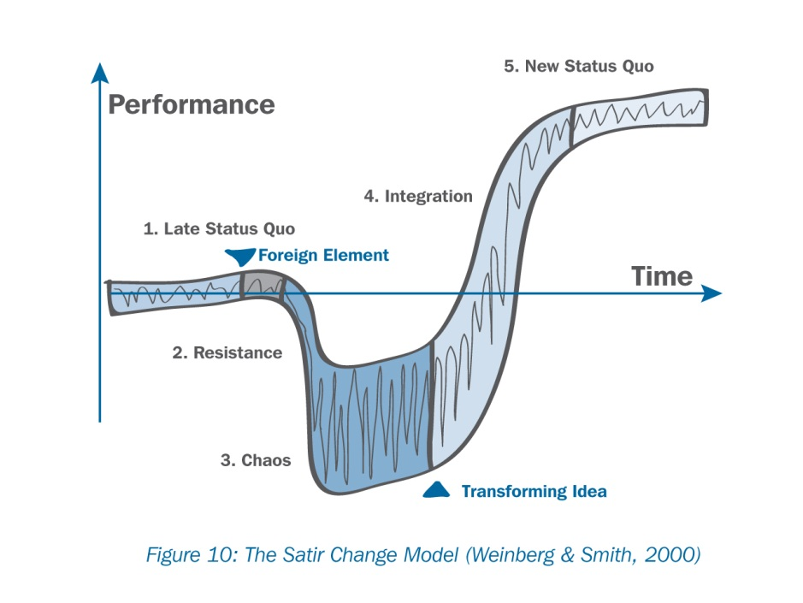
Four Tools for Adapting
OODA Loop (adapted from (Boyd, 1995)
Purpose Alignment Model (Pixton, Nickolaisen, Little, & McDonald, 2009)
The Short Horizon Model
The Satir Change Model (Weinberg & Smith, 2000)
Notes:
Strategic Focus—Steve Jobs
Capital One found they were using 17 different change models.

Slide 70

Exploring
Exploring
Notes:
Hard to break the mindset of Plan-Do
Many feel safe and in control when the “Plan” is clear upfront, but we have to get comfortable with EMERGENCE, experimentation and discovery
Lay out a vision and explore
It’s not “Plan or Don’t Plan”. It’s create a vision, plan some, execute some, and plan again.
Irony: Agile approach give us more confidence over time than Big upfront planning

Slide 71
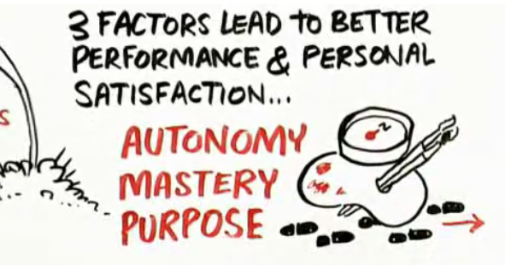
Engage/Inspire
Daniel Pink, Drive: The Surprising Truth about What Motivates Us
Notes:
Autonomy: People want to have control over their work.
Mastery: People want to get better at what they do.
Purpose: People want to be part of something that is bigger than they are.
These correlate to agile practices:
Self-organizing teams
Technical excellence
Product visioning

Slide 72
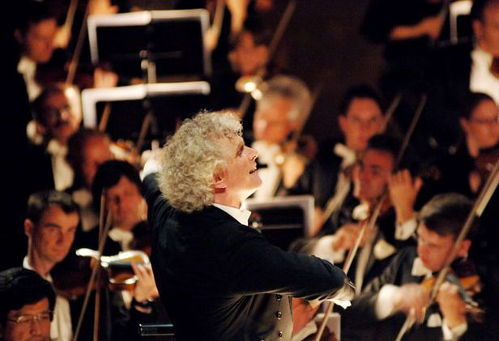
Engage—Facilitating
CLARIFY
CONNECT
Notes:
CONNECT PEOPLE IN MEANINGFUL WAYS
BRING CLARITY AND FOCUS TO AMBIGUOUS SITUATIONS
Facilitating is the active form of “Don’t micromanage”
Our job is not to tell people what to do and how to do it – it’s to set context and and then help marshal resources and remove obstacles so that our teams can make things happen
Servant Leadership – establish an environment in which teams and people are empowered to the maximum extent possible
Recruiting talent, Giving them the resources, and then Cross-pollinating ideas
Doesn’t mean abdicating all authority and decision-making
Establish an environment in which teams & people are empowered to the extent possible.
Leaders do not abrogate their decision responsibilities.

Slide 73
Create an Innovative Team Culture
Self-organizing
Autonomy
Delegation
Team Engagement
Empowerment
Leadership
Decision Framing
Peer-to-Peer

Slide 74
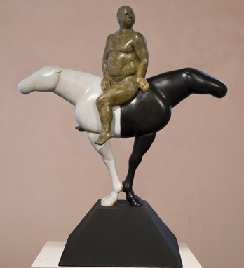
Riding Paradox
Paradox NOT = Problem
Notes:
Problems & Paradoxes are different!
Riding, not Controlling
Both/And not Either /Or thinking
Manager, on the horse, is exposed.
Courage
OK to be wrong, but not to be uncertain
Technical: BUFD versus No-BUFD
The same answer may not work tomorrow, or on the next project or release.
Biggest for agile leaders: Adaptable & Predictable at the same time.
Now, 3 key paradoxes for Agile leaders

Slide 75


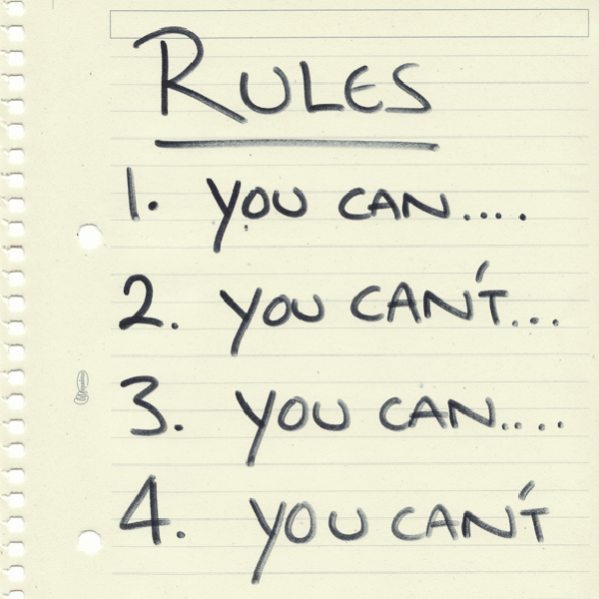
Agile 101
Notes:
To Ride Paradox, you have to move beyond prescriptive RULES.
Too many organizations are stuck at Agile 101 and practice prescriptive agility – they are as rigid in their agile implementations as they were with their heavier methodologies
Understanding the rules is a necessary first step in agile adoption
TRANSITION: but after that, Riding Paradox requires us to use our judgment to know which rules to follow and which we can bend

Slide 76
Paradoxes & Problems
Problems may be simple or complex, but once an effective solution is implemented, the problem is solved.
Paradoxes, on the other hand, are the hard core contradictions in organization life that cannot be resolved—they must be constantly balanced.
Problem solving follows a predictable pattern: Highlight an issue, gather the facts, investigate causes, formulate solutions, and implement the answer.
But what happens if there are issues for which solutions are non-existent? Here are some examples: Should we…
Focus on the short or long-term?
Invest in new business initiatives or maximize profits from existing businesses?
Centralize operations or decentralize them?
Hold individuals accountable for results or teams?
Source: http://stephenjgill.typepad.com/performance_improvement_b/2010/06/managing-paradox.html.

Slide 77
Paradoxes for Adaptive Leaders
Yin | Yang
Control | Freedom
Accountability | Autonomy
Top-down Hierarchy | Self-organizing
Predictability | Adaptability
Managers and Edicts | Peers and Norms
Hierarchies | Networks
Efficiency | Responsiveness

Slide 78
7 Classic Management Paradoxes
Individuals and Teams: Individuals give of their best when they work in teams; teams succeed when each individual pulls their weight.
Success and Failure: In order for people to succeed, you must first allow them to fail.
Work and Rest: To produce their best work, people need to rest. Or as Indira Gandhi once said: "You must learn to be still in the midst of activity, and vibrantly alive in repose."
Hard and Soft Skills: You need both hard skills such as logical intelligence and soft skills such as emotional intelligence. Just as the skilled potter needs soft ways to mold the clay and hard ways to fire it.
Efficiency and Effectiveness: The customer is best served when the organization is efficient; the organization is effective when it puts the customer first.
Control and Freedom: People need controls to be free. Freedom can only be bought with restraints.
Change and Stability: To change safely, we need a stable base. To find stability, we need to change ourselves often. Or as Alfred Whitehead put it: "The art of progress is to preserve order amid change and to preserve change amid order."
Source: http://www.zeromillion.com/business/paradoxes.html

Slide 80
More Information
White paper: “Adaptive Leadership: Accelerating Enterprise Agility,” Jim Highsmith, Available on www.thoughtWorks.com.
My blog: www.jimhighsmith.com.
Twitter: @jimhighsmith

Slide 81
Adaptive Leadership
Continuous
Discovery
Continuous Development
Continuous Delivery
Innovation Lean Startup Experience Design Product Mgt
Agile Architecture Mobility Cloud Analytics Big Data
Automating the Last Mile
Fast, Adaptable, Sustainable
Build Software; Build Capability
We turn your ideas into products.

